Slide 1

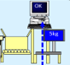
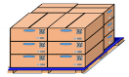




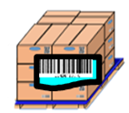

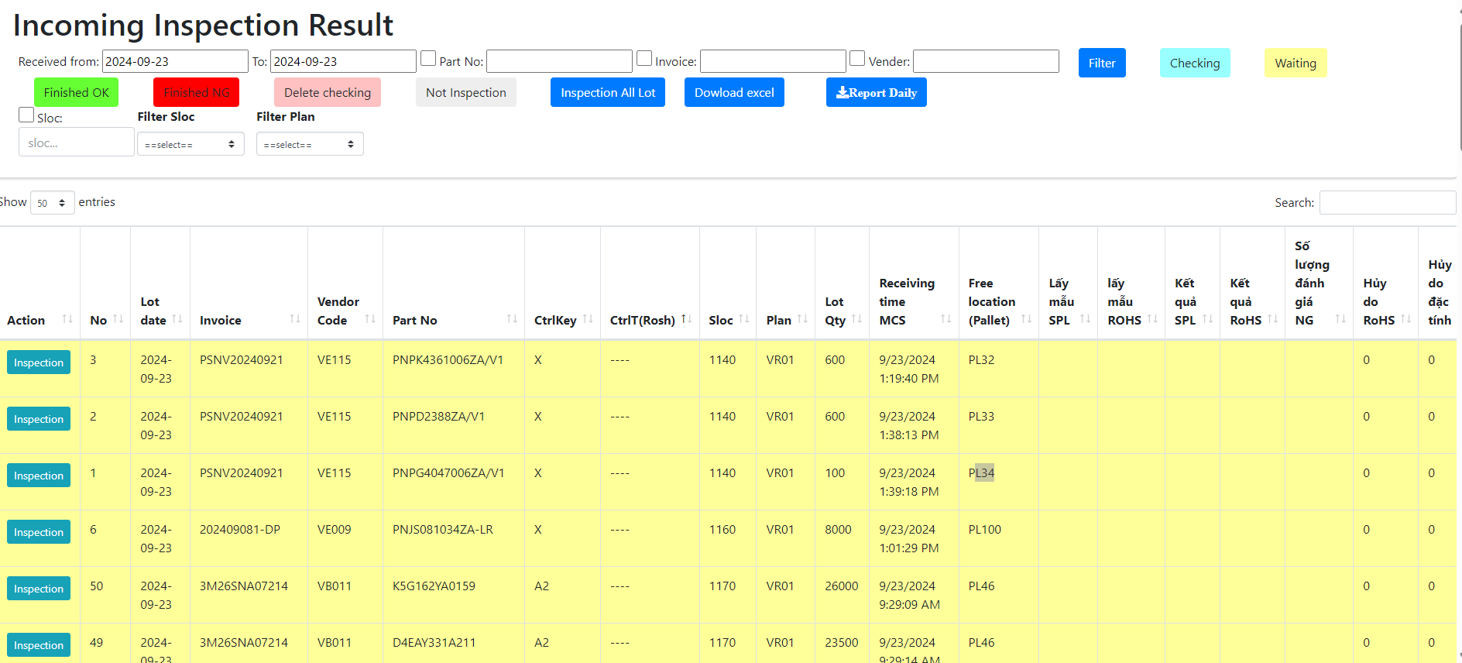
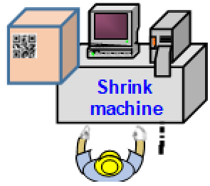
OQC DIGITAL SYSTEM
1
1
Pick up simple
OQC Inspection
Chop stamp physical
Shipment
OQC manual control when picking up samples
FA does not control quantity of OQC pick-up
No indicate shipment priority
Manual control weight check
Update OQC result not timely
Each step is an independent, easy-skip process
Manual make report
OQC: Loss time to find and chop stamp.
FA loss of time to check stamps by appearance check
SCM loss of time to confirm OQC inspection result to input WMS
CURRENT
OQC inspection
FA warehouse
(E-map control)
SCM warehouse
OQC
Pick sample
Software
OQC Judgement all lot
WMS
Weight check
NEW SYSTEM
Database server
Return sample
FA In/Out location
Database Weight check
FA create Pallet ID
Visualize OQC inspection result
System indicate S/N OQC pickup
Indicate models shipment priority
System indicate OQC & Lot judgment
Reduce manual job OQC
➔ Save: 1,000H/year
E-chop and indication on system
FA: Save 213.4$/year
OQC: ∆2pax
E-chop and indication on system
SCM: Save 800H/year
AFTER

Slide 2
OQC DIGITAL SYSTEM
2
Overview of the OQC inspection process
Steps
Analysis
1
NG
Notify NG error for FA
Pick up sample
OQC inspection result no link FA & SCM system, easy mistake. (7 steps)
2
9
First check
Find Pallet ID & F/G
OK
3
OQC inspection
10
Matching Pallet ID & Outer carton
4
OQC inspection
11
Record Pallet ID & S/N carton
All procedures are manual by Excel, loss time to traceability, and skip processes.
5
Check S/N inner product
12
Find all lots same model, shift, date, line
6
Weight 2nd
The results of the inspection process are manually stamped. Loss of time to stamp.
7
Second check
13
Chop stamp physical all lots
8
Return sample
14
Report daily
OQC chop stamp procedure

Slide 3
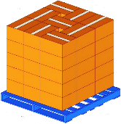
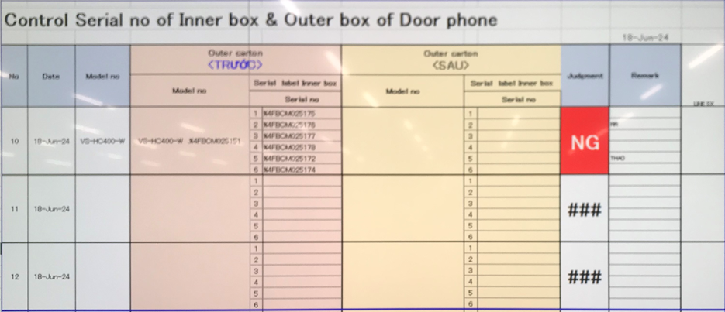
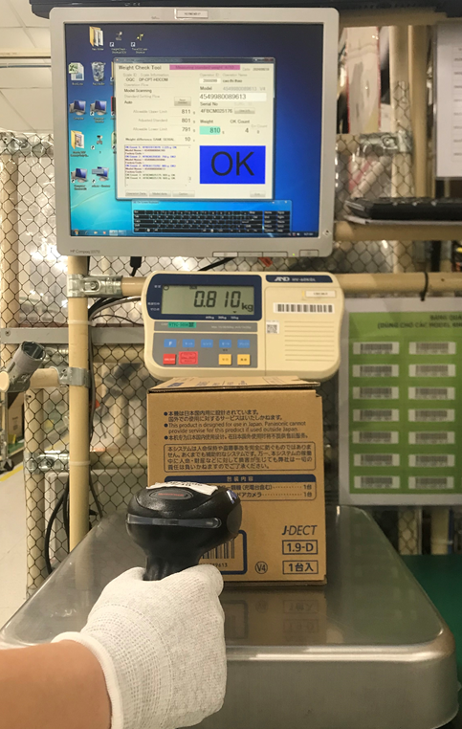
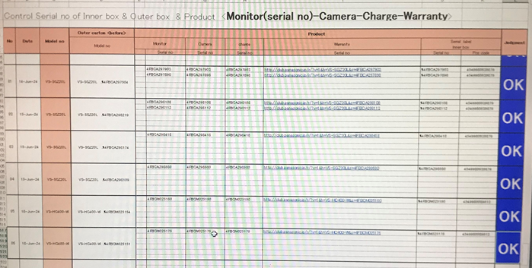
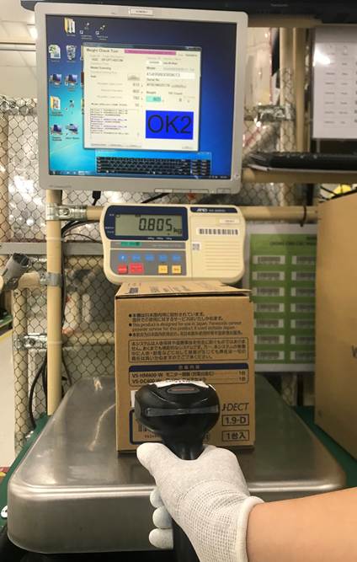
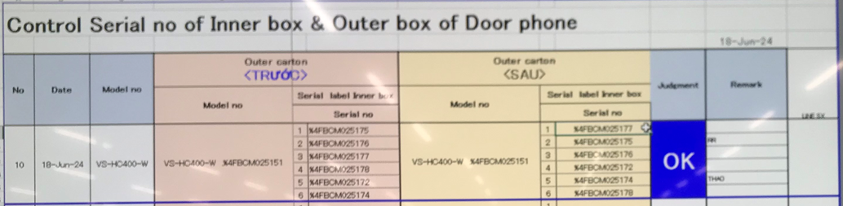

OQC DIGITAL SYSTEM
3
Control process sample at OQC area
Pick up sample
Reading barcode Inner/Outer excel file
Weight check 1st
OQC
inspection
Reading BC
Product/Inner excel file
Weight check 2nd
Reading barcode
Inner/Outer excel file
Return sample
No Link
2
No Link
3
4
No Link
5
6
7
8
1
No Link
Reliability
No Link
No Link
No Link
Production Line
Confirm S/N Outer & all inner boxes
Accessory control
Numbering control & Separate area
Product / Warranty/ Manual & Inner box
Accessory control
Confirm S/N Outer & all inner boxes
Warehouse FA
Improvement
Steps
1
2
3
4
5
6
7
8
Auto link weight FA
Auto link weight FA
Database server OQC
Control pick-up quantity

Slide 4

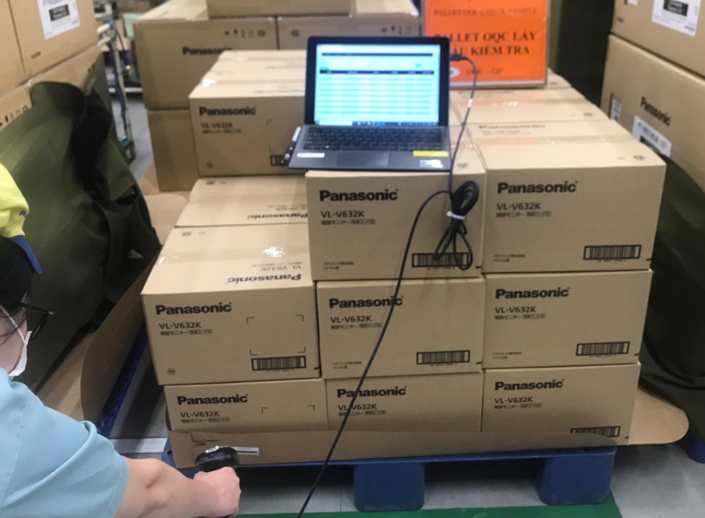


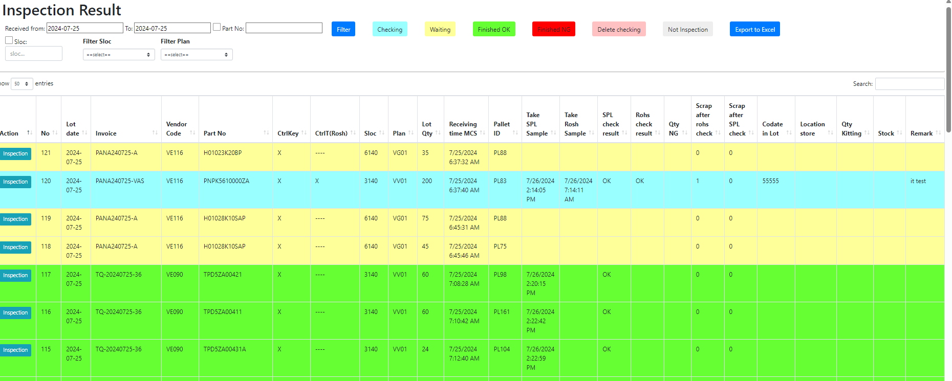
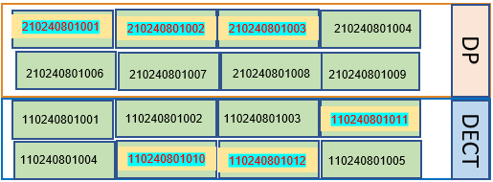


OQC DIGITAL SYSTEM
4
E chop for OQC inspection
Line 1A
OQC inspection
OK
Steps
9
10
11
12
13
14
Line 2A
Day- Month- Year
Line 3A
OQC
NG
OK
Line 4A
OQC member pick up sample
Auto judgment OK for
All pallet ID the same Model, production date, line and shift.
Use physical stamp
Line 5A
NG Location
Database server
Production line
New system link FA-SCM-OQC
DP area
FA
Link
OQC
Link
SCM
E – chop can
replace
Shrink machine
Visualize OQC inspection
OK
OQC return sample
FA shrink pallet ID
FA fix location
Day- Month- Year
OQC
SCM Warehouse
SCM Out location
SCM area
DECT area
Visualize FA Warehouse area
WMS system
Shipping To market

Slide 5
OQC DIGITAL SYSTEM
Analysis of OQC System Functional Diagram
Make Planning
SCM
Send file inventory & shipment plan
FA
Compare Stock base on file plan and update
OQC
PCS
Send daily production plan
Step 1
OQC
Filter priority shipmen models to inspection
Input daily production to excel file
Pick up sample to Inspection
Based on the production plan file of SCM
Based on sample standard file
Pick up samples based on weight check system results
Step 2
OQC
Scan barcode outer serial
Scan all barcodes inner serial
Confirm S/N Outer & all inner boxes

Slide 6
OQC DIGITAL SYSTEM
Analysis of OQC System Functional Diagram
Step 3
OQC
Weight check 1st
Product weight control
Step 4
Normal inspection
Appearance inspection, function, WI
OQC
OQC
inspection
Reliability inspection
Characteristic, Vibration, Drop, Temperature test
Step 5
OQC
Scan barcode inner product
Based on the mater list

Slide 7
OQC DIGITAL SYSTEM
Analysis of OQC System Functional Diagram
Step 6
OQC
Weight check 2nd
Product weight control
Step 7
OQC
Scan barcode outer serial
Scan all barcodes inner serial
Confirm S/N Outer & all inner boxes
Step 8
OQC
Return sample
Judgment all Lot

Slide 8
OQC DIGITAL SYSTEM
Chop stamp process of OQC
Packing FA
FA shrink Pallet ID
ID Pallet Station
FA warehouse
SCM warehouse
Case 1
NO ID Pallet
Case 2
ID Pallet issue in FA process
OQC get sample
None Pallet
Chop stamp physical, record by excel file
OQC get sample
Return sample
Find all pallet same model, production date, line, shift
OQC Inspection
NG
OQC Inspection
OK
NG
OK
return sample
Maching ID Pallet and Outer carton before return
Find & Return correct Pallet ID taken
Notify NG error for FA

Slide 9
OQC DIGITAL SYSTEM
Rule to Judge 1 LOT
Define 1 lot:
When a model runs, another model inserted will be counted as 1 lot. (Lot: when a new model is inserted or finishes a working shift)
Judgment 1 lot:
OQC will judge a lot after finishing the inspection of all sample quantities even though the production result is not finished yes.
1st sample
2nd sample
……
N sample
Final Judgment for Lot
OK
OK
OK
OK

Slide 10
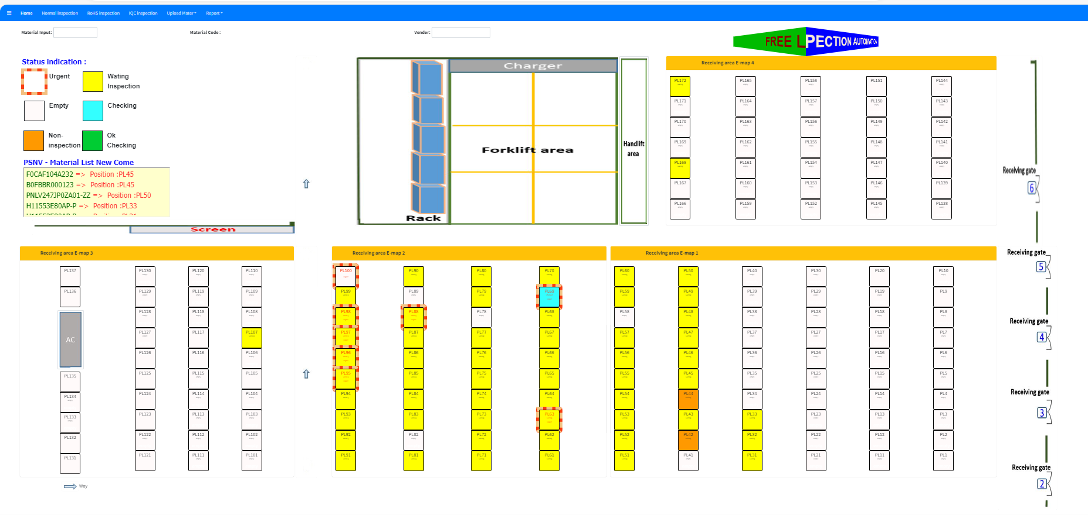
OQC DIGITAL SYSTEM
15
Visualize status of Lot
Indication location at warehouse
Status situation
Not checked yet
Checking
Checking
<Can move pallet>
OK
NG
Not checked yet : OQC not taken sample yet
Checking : Under OQC checking
Checking : Under OQC checking (Sample Q’ty already checked over a half Q’ty of all sample)
<Can move pallet>
OK : All Lot judgment OK
NG : Lot judged NG
OQC inspection indication
Location indication at warehouse

Slide 11
SCHEDULE OQC DIGITAL SYSTEM
Plan
Actual
Go-live
No | Items | Dept | Aug | Sep | Oct | Nov | Dec | Jan | Feb | Mar
1 | Meeting, discuss, analyze | SCM/QC/FA/IT
2 | Confirm shortage shipment | SCM/QC/IT
3 | Upload production plan | SCM/QC/IT
4 | Pick-up sample | QC/IT
5 | Confirm Outer carton and inner box | QC/IT
6 | Modify weight check OQC | QC/IT
7 | OQC normal inspection | QC/IT
8 | OQC Reliability inspection | QC/IT
9 | Confirm all serial of product for ensure matching serial No | QC/IT
10 | Return sample | QC/IT
11 | Function OQC judgment all lot for production result | MCS
12 | Visualize inspection result OQC for FA | PMD
13 | Visualize inspection result OQC for SCM | PMD
14 | Visualize inspection result OQC with WMS of SCM | FA
15 | Report daily OQC | SCM

